Slide 1

Path-Planning Algorithms for Efficient Maze Navigation in Webots
José Guilherme Marques dos Santos
202208081

Slide 2
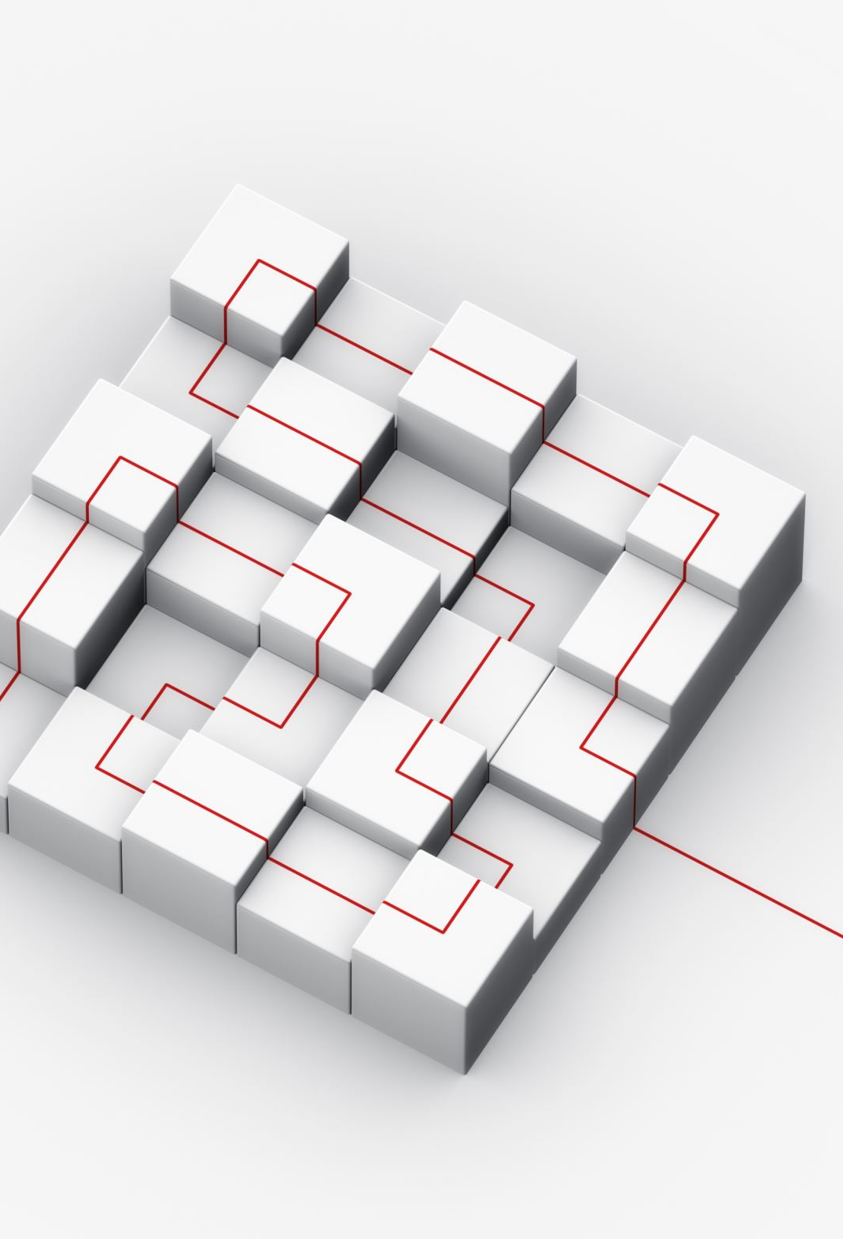
Summary of the goals of the work
Implement three path-planning algorithms (A*, D* Lite, RRT) within the Webots simulator to enable direct comparison
Generate and navigate random grid mazes of varying sizes (3×3 to 10×10 cells) and dead-end complexities (clusters of 1, 5, and 10 cells) to test each planner under controlled conditions
Measure four key performance metrics for each algorithm:
  Graph-construction time
  Path-planning time
  Traversal time (at 0.2 m/s)
  Path length (in discrete steps)
Analyze trade-offs between computational overhead and path efficiency, providing recommendations for the selection of planners for different application scenarios (static vs. dynamic, time-critical vs. optimal routes)

Slide 3
Motivation
Critical role of autonomous navigation
  Autonomous robots must compute collision-free trajectories to traverse diverse environments (e.g., driving automation, planetary exploration).
Real-world demands on performance
  Time-critical applications (e.g., search-and-rescue, congested driving) need rapid adaptation to changing terrains and dynamic obstacles.
  Algorithms with high computational overhead may be unsuitable despite optimal paths; faster but suboptimal routes may lead to wasted energy and hardware wear.
Lack of comprehensive empirical data
  Existing benchmarks often focus on either planning efficiency or path quality, but not both across varied scenarios.
  A systematic evaluation is needed to map trade-offs between graph construction time, planning time, traversal time, and path optimality under controlled conditions

Slide 4
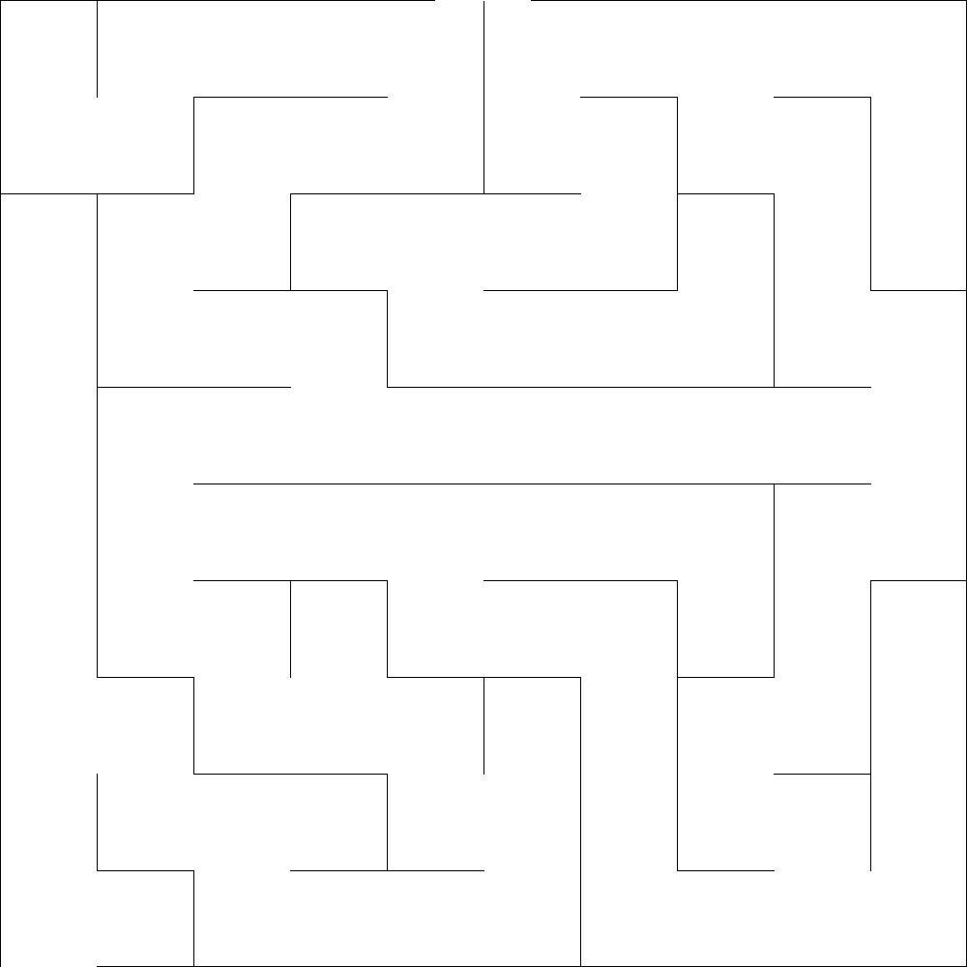
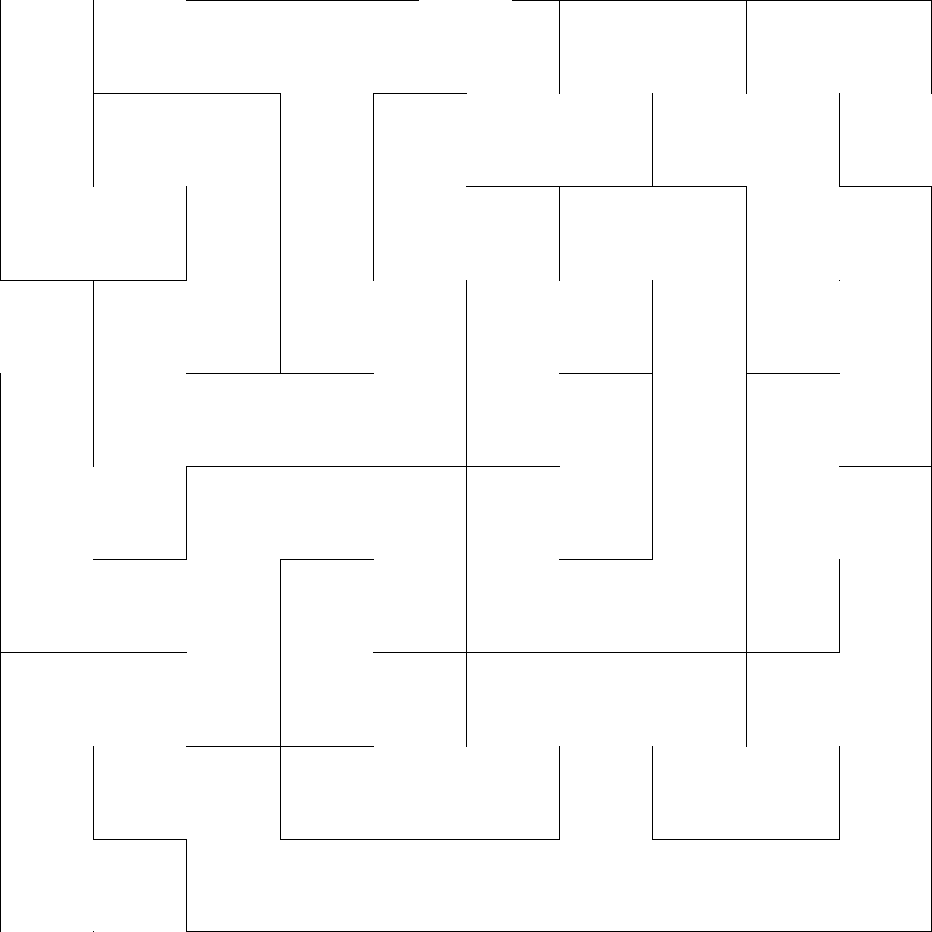
Approach to solve the problem
Maze Generation:
Parameters:
  Grid dimensions (width × height in cells)
  Output image size (pixels)
  Dead-end length index (1-10, higher = more loops)
10×10 maze with dead-end length index 1
10×10 maze with dead-end length index 10

Slide 5
Approach to solve the problem
Algorithms:
  A*
    Builds full grid graph
    Heuristic: Euclidean distance to goal
    Expands lowest-cost node until goal reached
  D* Lite
    Incremental repair of A*-style graph when costs change
    Maintains g- and rhs-values per node
    Propagates cost updates only where needed
  RRT
    Initializes tree at start
    Loop: sample point → nearest tree node → “steer” by fixed step
    Add collision-free nodes

Slide 6
Experiments conducted
Maze Parameters used:
  Grid dimensions: 3x3, 5x5, 8x8, 10x10
  Dead-end length index: 1, 5, 10 for each grid dimension
  10 independently generated mazes per size–index combination
Evaluation Metrics:
  Graph-construction time: Time to build grid graph or tree structure
  Planning time: Time to compute a complete collision-free path
  Traversal time: Time for the E-puck to physically follow the path at 0.2 m/s
  Path length: Number of discrete steps from entrance to exit

Slide 7
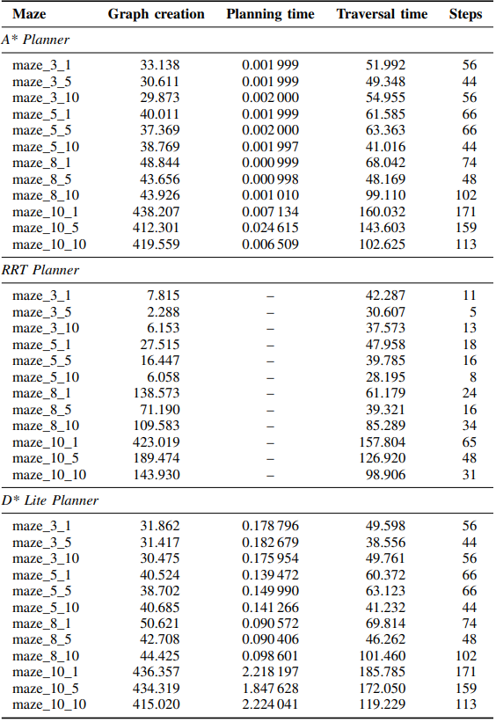
Discussion of the results
A*
  Delivers the fastest path‐planning durations (0.001–0.025 s)
  Most optimal path in term of grid-based methods
D* Lite
  Slightly higher preprocessing costs
  Traversal performance similar to A*
RRT
  Constructs its search structure almost instantaneously
  Compact trajectories that minimize end-to-end traversal time

Slide 8
Conclusion
A*
  Performance degrades on larger mazes due to expensive graph construction
  Fastest planning times and optimal paths in static, fully known environments
D* Lite
  Balances preprocessing cost and path optimality via dynamic replanning
  Suited to changing or partially known environments
RRT
  Nearly instantaneous graph building and compact trajectories
  Small-scale or time-critical tasks tolerating slight suboptimality

Slide 9
Future works
Dynamic & Uncertain Environments:
  Extend benchmarks to moving obstacles and partial maps, stressing D* Lite’s replanning
Real-World Validation:
  Test on physical robots (E-puck, TurtleBot) to measure sensor noise, actuation errors, communication delays
Hybrid & Learning-Based Methods:
  Explore PRM–RRT hybrids and ML-driven heuristic/sampling bias tuning
Energy & Resource Metrics:
  Incorporate power consumption, CPU/memory usage, and robustness for embedded platforms
Multi-Agent Coordination:
  Investigate cooperative maze navigation: collision avoidance, task allocation, communication strategies

